Slide 2
Human Decision Making in the Era of Coronavirus
Andy Ellis
CSO, Akamai
@csoandy

Slide 4



Disaster Planning
Are workers okay?
Can they get to the building?
Is the building open?
Does the building work (power, internet)?

Slide 5



Slide 6






Slide 7

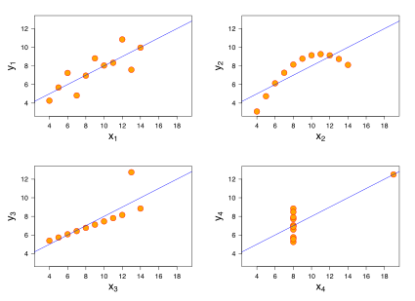






OBSERVE
ORIENT
ACT
DECIDE

Slide 9
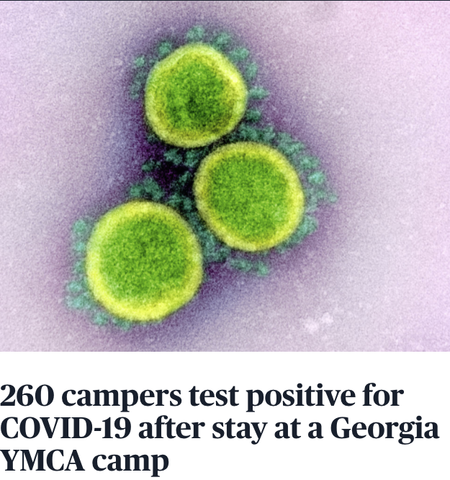
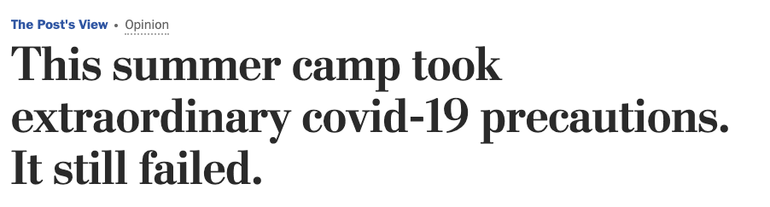

Slide 10
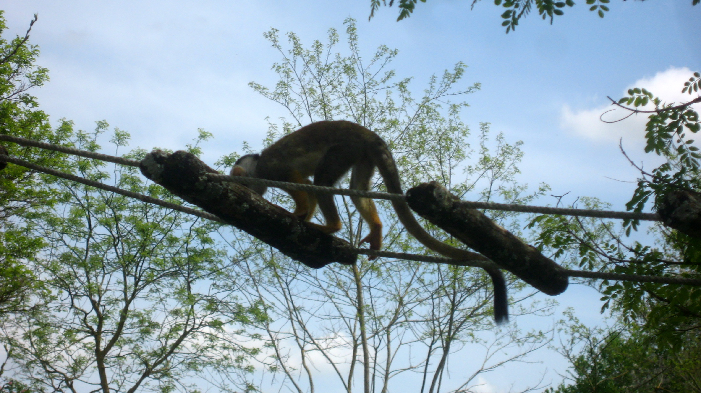
Historical paranoia
“Monkey on rope ladder” by Rachel Coleman Finch is licensed under Creative Commons 2.0 Generic
| @CSOAndy

Slide 11
Prisoner’s
Dilemma
Loyal
Actual Prisoner’s
Dilemma
Loyal
Loyal
13%
-3
30%
-3
Betray
Betray
If we believe our “partner” will cheat on us, we’ll cheat first.
Different communities have different expectations!
-1
-10
-10
-1
40%
-5
19%
-5
Betray

Slide 12


Slide 13
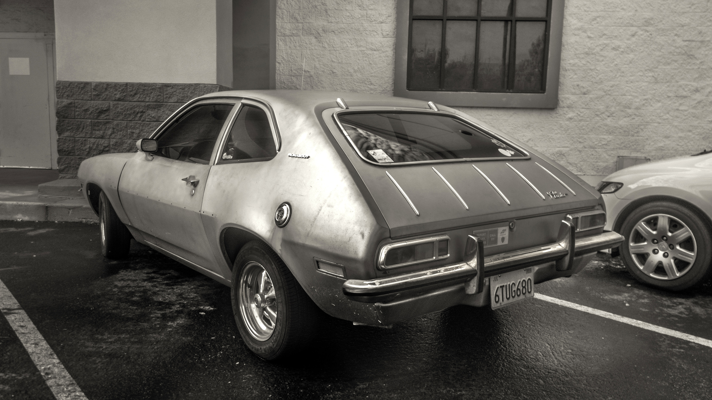
Hazards used to be simple…
“Attention Walmart Shoppers” by Robert Couse-Baker is licensed under Creative Commons 2.0 Generic
@CSOAndy

Slide 14
… but now risks are more complex.
Image Source: Jeep®
@CSOAndy

Slide 15



The Goal: Good, Fast, Cheap Decision Making

Slide 17
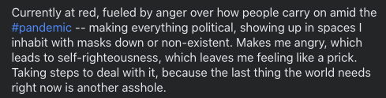
Anger makes for hard decisionmaking….

Slide 18
Why do people make incomprehensible decisions?
Everyone is a villain in someone else’s story.
Modal
Bias!
You
Me

Slide 19

Gordon’s Stages of Learning
Unconsciously Skilled
Consciously Skilled
Consciously Unskilled
Unconsciously Unskilled

Slide 20
OODA Energy Spent
UNSKILLED
OBSERVE
ORIENT
UNCONSCIOUSLY
CONSCIOUSLY
ACT
DECIDE
SKILLED

Slide 21

OBSERVE
ORIENT
ACT
DECIDE

Slide 22
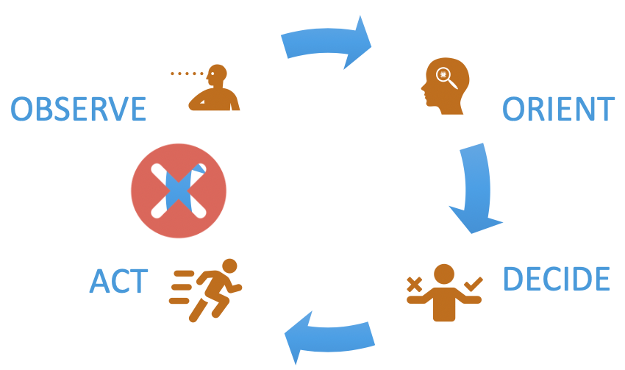
OBSERVE
ORIENT
ACT
DECIDE

Slide 23
Predict the future to detect being wrong more often
And inspect the past

Slide 24
An office closing decisionline…
Work from home
(WFH)
“authorized”
Office
closes
WFH until
30 Sep 2020
WFH until
30 Jun 2020
WFH
“default”
WFH until
30 June 2020
WFH until
31 Dec 2020

Slide 25
… but with limited perspective
Work from home
(WFH)
“authorized”
Office
closes
WFH until
30 Sep 2020
WFH until
30 Jun 2020
WFH
“default”
WFH until
30 June 2020
WFH until
31 Dec 2020

Slide 26

Pre- and post- mortems

Slide 27
OBSERVE
ORIENT
ACT
DECIDE

Slide 28
Neurocognitive party tricks
What color is snow?
What color is snow?
What color is snow?
What color is snow?
What do cows drink?
Taylor buys a baseball glove and ball for $105.
The glove cost $100 more than the ball.
What did the ball cost?
LEFT
RIGHT
LEFT
RIGHT
LEFT
LEFT
LEFT
RIGHT
RIGHT

Slide 29
OBSERVE
ORIENT
ACT
DECIDE

Slide 30
Human Decision Making in the Era of Coronavirus
Andy Ellis
CSO, Akamai
@csoandy

